Slide 1
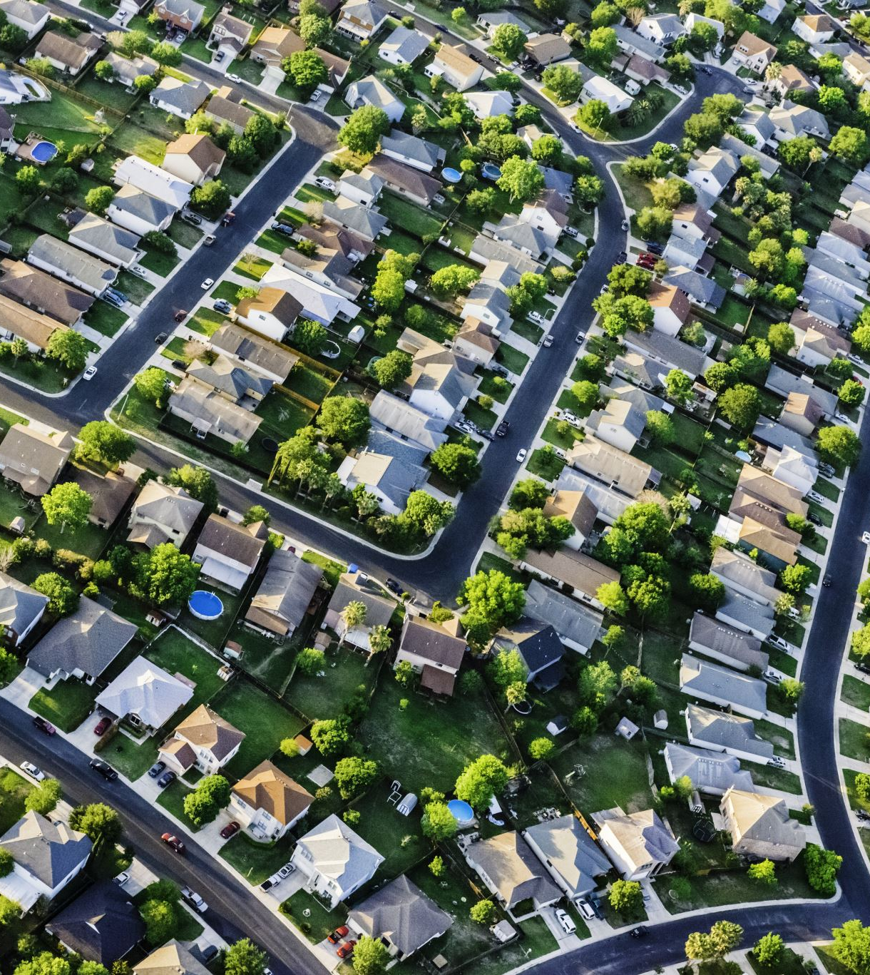
Housing Sale Price prediction with the King County Housing Dataset
Pinal Patel
Academic Xi

Slide 2

Process
The Data
Data cleaning and pre-processing.
Exploring the data
Building regression models
Validation of the model
Result

Slide 3
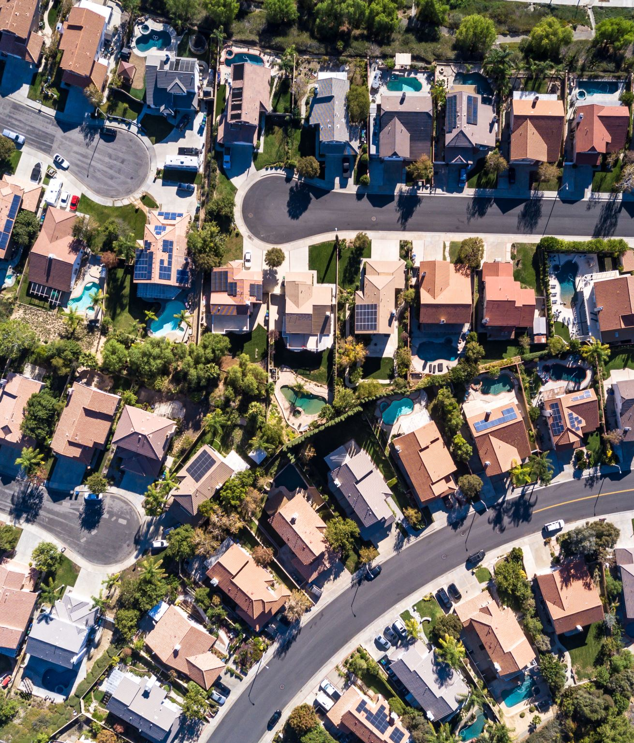
The Data
The King County Housing Data Set contains information about the size, location, condition, and other features of houses
Id, date, price bedrooms, bathrooms, sqft_living, sqft_lot, floors, waterfront, view, grade, sqft_above, sqft_basement, yr_built, yr_renovated, zipcode, lat, long sqft_living15, sqft_lot15

Slide 4
Business Problem
RGB need to provide prospective home sellers with guidance on how to improve the value of their home prior to listing, including the predicted increase in value expected based on improvements to features.

Slide 5
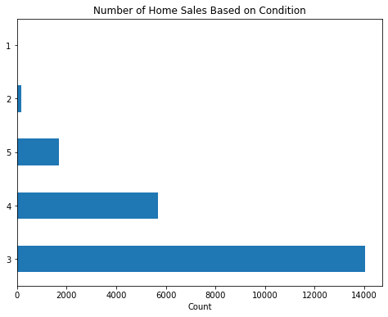
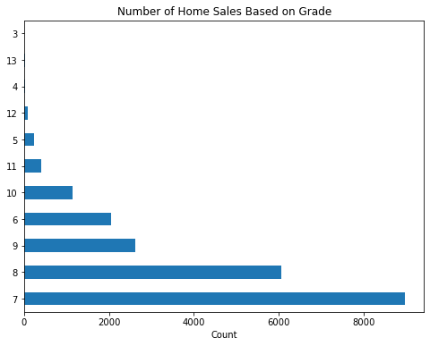
Exploring the Data

Slide 6
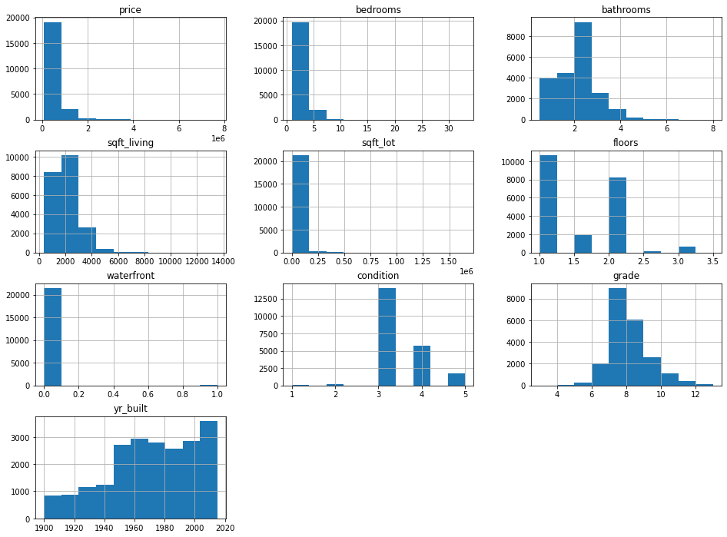
Histogram
Many of the variables do not follow a normal distribution, and the scales are dramatically different for some variables. This may create issues with satisfying all regression assumptions, but we'll address those issues as they arise. Regression does not require features to be normally distributed

Slide 7
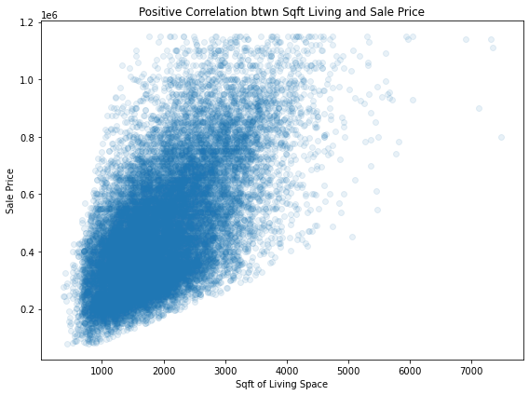
Checking correlations

Slide 8
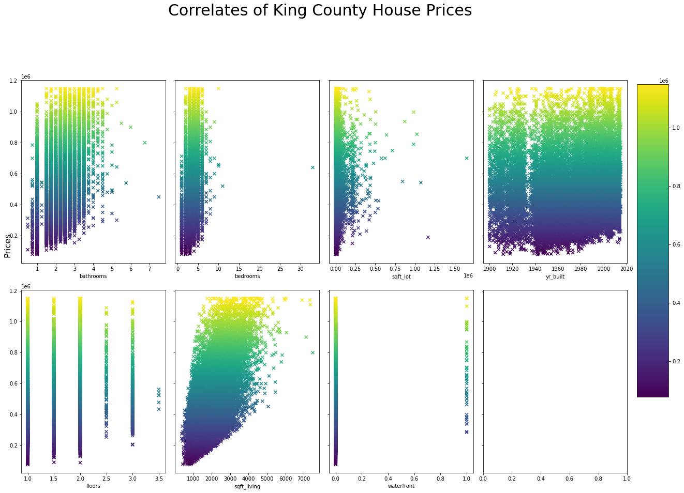
Checking correlations
There is no obvious linear correlation between the variables "floors," and "bedrooms" and “waterfront” of a home. Sqft living will be employed in the multiple regression model because it has a better linear association with pricing than sqft lot.

Slide 9
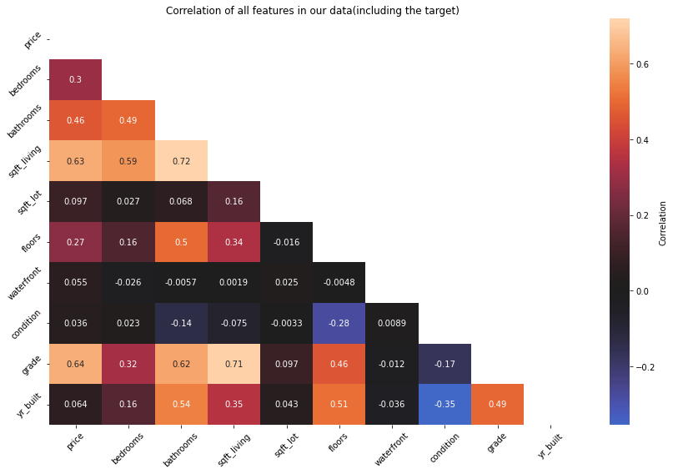
Multicollinearity
price 1.000000
grade 0.635934
sqft_living 0.627438
bathrooms 0.460266
bedrooms 0.298955
floors 0.273616
sqft_lot 0.097296
yr_built 0.063956
waterfront 0.055232
condition 0.035714
Name: price, dtype: float64

Slide 10
Model Testing
There should be a linear relationship between the explanatory and response variables (already checked).
The data should be homoscedastic (i.e., the residuals have equal variance around the regression line on a scatterplot).
The model residuals should follow a normal distribution (i.e., the residuals fall along a relatively straight line on a QQ plot.)

Slide 11

Final Model and Results
Train Mean Squared Error: 2.14597995431184e-18 Test Mean Squared Error: 2.1514436620943857e-18
Correlations Features
0 0.718648 [bathrooms, sqft_living]
1 0.718648 [sqft_living, bathrooms]
2 0.709002 [sqft_living, grade]
3 0.709002 [grade, sqft_living]
price ~ sqft_living + grade + bathrooms
R 2=.47
P < 0.05
Train Mean Squared Error: 2.14597995431184e-18
Test Mean Squared Error: 2.1514436620943857e-18

Slide 12
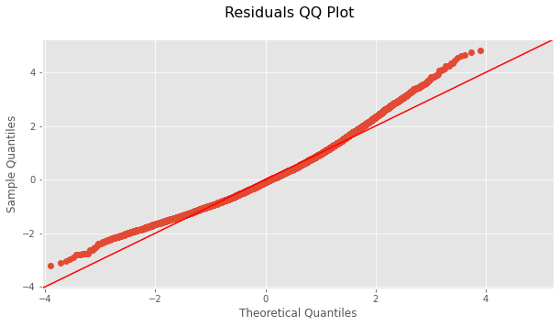

Slide 13

Recommendations
Improve construction quality
Expand living area
Add a bathroom

Slide 14
Thank You
https://github.com/pinalnikhil/KingCountymultilinearregression.git

